Slide 1

DATA FOR SOCIAL GOOD HACKATHON
THE QUAD SQUAD
PRAJWAL
HARSHITH
SHRUTHI
AMRUTH

Slide 2
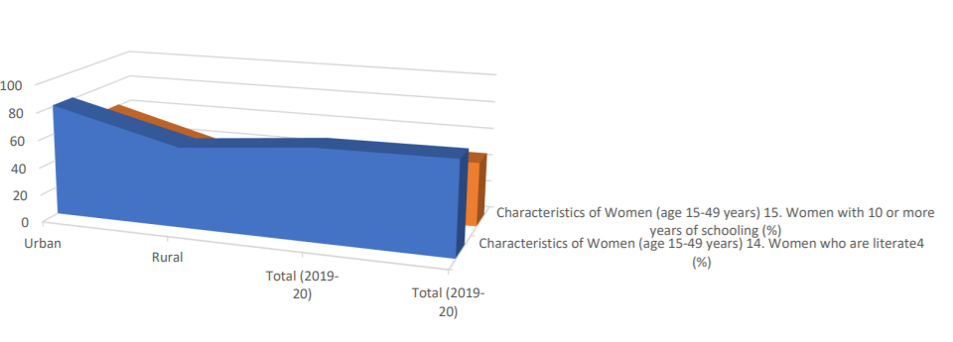
It can be inferRed that Whilst Women with illiteracy rate has been decreasing in Urban Areas over the years, there isn't much change of that in Rural Areas

Slide 3
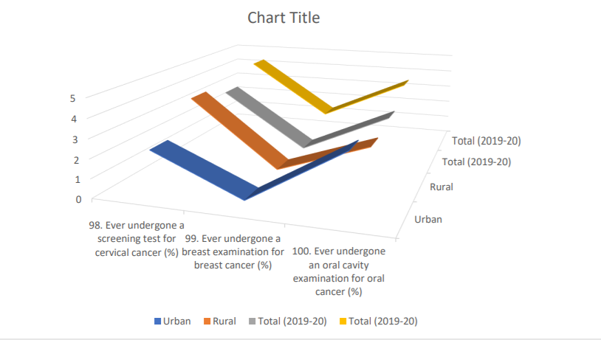
ALSO WE CAN INFER THAT THERE IS A GENERAL LACK OF AWARENESS OF HOW NECESSARY IT IS FOR WOMEN TO HAVE CASUAL CHECKUPS FOR CANCERS SUCH AS CERVICAL, BREAST AND ORAL, NEGLIGIBLE PERCENTAGE OF URBAN WOMEN AND EVEN LESS RURAL WOMEN UNDERGONE SCREENING

Slide 4
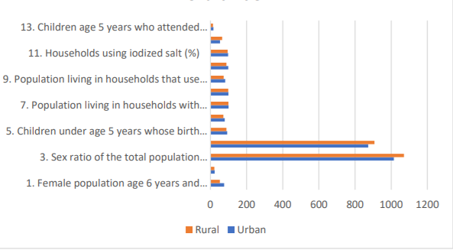
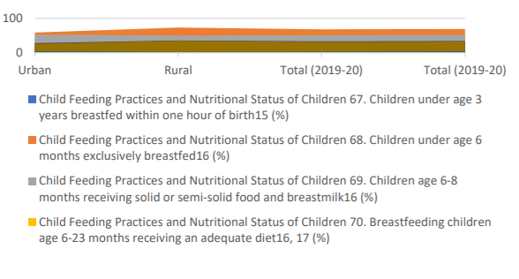
COMPARING THE PROFILES OF HOUSEHOLDS IN URBAN AND RURAL, WHILST THE POPULATION AGED LESS THAN 15 YEARS ARE APPROXIMATELY EQUAL, THERE HAVE BEEN VAST DIFFERENCES IN GIRL CHILD EDUCATION, SEX RATIO AND BIRTH DEATH REGISTRATIONS

Slide 5
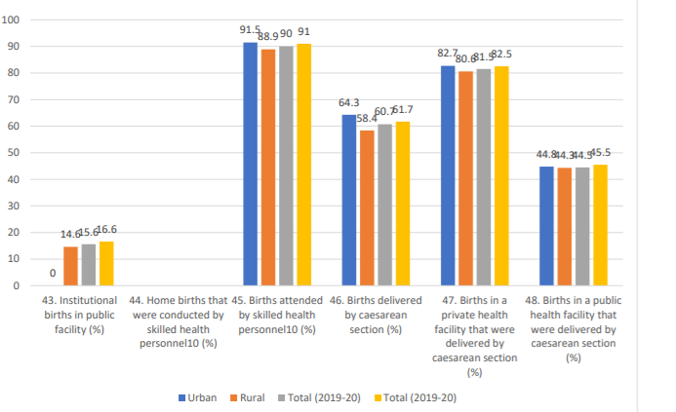
COMING TO DELIVERY CARE, HOME BIRTHS ARE MORE AT RURAL INDICATING THAT THEY DO NOT PROGRESS AS RAPID AS URBAN EVEN WITH CHANGE IN YEARS

Slide 6
THANK YOU

